Slide 1
Transfer Talk #3
Partnership Programming to Ensure a Smooth Transfer Transition
May 17, 2018
1:00 – 2:00 PM
Slides will be available on IndianaTransferCouncil.org after the Transfer Talk.

Slide 2
Before we begin…
Please be sure to mute your phone line.
Use the chat box for questions.
Turn webcam off.

Slide 3
Agenda for Transfer Talk #3
1:00 - 1:10 - Welcome
Indiana Transfer Council & Transfer Talks
Presenter Introductions and Overview of Talk
How Can You Adopt These Programs to Facilitate Smooth Transfer?
Julie Landaw, Professional Development Director, Indiana Transfer Council
1:10 - 1:30 - 4 Touchpoints to Ensure Smooth Transfer
Dr. Barbara Wylie, Program Chair Indianapolis Service Area, Statewide Elementary Education Program Chair Indiana, Ivy Tech Community College
1:30 - 1:40 – Pathway to Purdue
Peg Wier, Associate Director, Transfer Specialist, Purdue University
1:40 - 1:55 - Questions & Discussion
1:55 - 2:00 - Overview & Wrap Up, Next Transfer Talk

Slide 4
Four Steps to Transfer Success
Presented by
Dr. Barbara A. Wylie Statewide Program Chair School of Education Ivy Tech Community College

Slide 5
The Need Identified
This began about 7 years ago after administering a student survey
Students identified areas of improvement for our department (Education/Indianapolis Region)
Area identified: Transfer support/Emotional support for the transfer process
Notes:
How presentation will benefit audience: Adult learners are more interested in a subject if they know how or why it is important to them.
Presenter’s level of expertise in the subject: Briefly state your credentials in this area, or explain why participants should listen to you.

Slide 6
Step 1
Began with having all gateway course sections (EDUC 101: Introduction to Education) use 1 course period to take a tour of IUPUI campus and meet with the Education Advisors in the School of Education at IUPUI
Outcomes
Students began to realize that IUPUI was not THAT big, nor THAT scary and it relieved a lot of fears students had about transfer...
…however, students felt like it was the school talking about all the good things that IUPUI had to offer and they wanted a connection with previous transfer students….
SO….
Notes:
Lesson descriptions should be brief.

Slide 7
Step 2
I instituted a student panel of students who have successfully transferred and are in each block (one student from each of the four blocks)
Sit for an open panel discussion at the beginning of the capstone course
Outcomes
Students get a student’s perspective about the transfer process, work load of the program, costs, pros/cons, etc…
Students get to connect with current IUPUI students/former Ivy Tech students showing them that everything will be better than ok! Contact information is shared so students have an on-campus contact with which to network.
But…..
Notes:
Example objectives
At the end of this lesson, you will be able to:
Save files to the team Web server.
Move files to different locations on the team Web server.
Share files on the team Web server.

Slide 8
Step 3
Students wanted to meet the instructors so they would know that they would be equally approachable, caring, and understanding as they were used to.
Invited faculty from IUPUI to come to our classes and chat about their discipline and the program at IUPUI.
Outcomes
This allowed students to put a name with a face and meet future professors.
Put students’ minds to rest

Slide 9
Most Recently
Recreated process for other colleges
Created an Education Student Council for the Indianapolis Region
10 students participating (self-identifying and volunteer participation)
Created out of the desire for student input about policy, practice, implementation
Many things came out of the 3 meetings we had this year (each meeting was 2.5 hours long)
Most relatable to this project was the idea of a capstone mentor
Outcomes
Beginning pilot of capstone mentors Fall 2018

Slide 10
…Continued
Currently working with Dr. Tillema on group registration dates for cohorts of students to ensure they have the support they need for the successful completion of the transfer process.
Pilot to begin in the Fall 2018

Slide 11
Ivy Tech Community College and Purdue University partnership
Peg Wier (765) 494-1271 pjmwier@purdue.edu
Purdue.edu/Pathwaytopurdue

Slide 12
What is the “Pathway to Purdue Agriculture”?
Partnership between Purdue University, College of Agriculture & Ivy Tech Community College – Lafayette
Allows Ivy Tech students to “co-enroll” at Purdue to prepare for an undergraduate degree in the college of Agriculture
Students simultaneously take courses at BOTH institutions
Completion of a Bachelors of Science in agriculture from Purdue University
The goal of the program is to make higher education more accessible to Indiana students

Slide 13
Co-Enrollment
Students will take courses full-time at Ivy Tech while completing at least one course each fall & spring as a non-degree seeking student at Purdue
Becoming a non-degree seeking student at Purdue gains access to Purdue’s libraries, student housing, recreational facilities, computer labs, student organizations, and athletic events (some access may require additional fees)
Co-enrollment also allows Ivy Tech students access to Purdue student housing
Application fee for Purdue non-degree seeking application will be waived
Students meet jointly with the appropriate Ivy Tech and Purdue College of Agriculture academic advisors

Slide 14
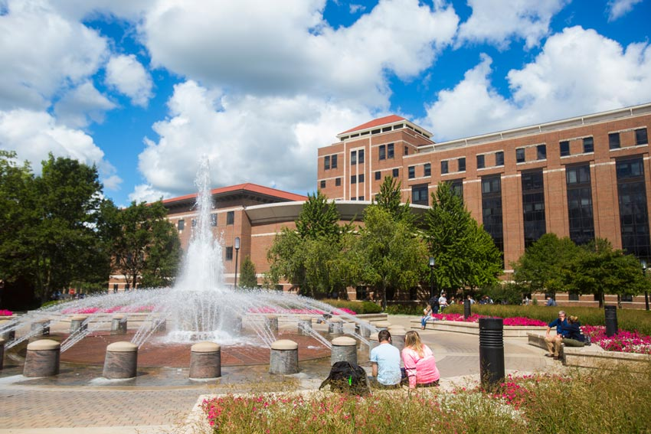
Ivy Tech – Lafayette & Purdue – W. Lafayette
The “Pathway to Purdue Agriculture” program is specific to students who:
Want to study agriculture
Who plan on attending the West Lafayette Purdue campus
Can attend the Ivy Tech in Lafayette as a Full-time student
The program only admits students for a Fall start

Slide 15
Eligibility for the program
Students must have the following requirements:
Be an Indiana resident
Will earn a high school diploma or equivalent certificate prior to enrollment
Earn a minimum 2.0 high school academic unweighted GPA*
Student must meet academic requirements for an associates degree at Ivy Tech
Have fewer than 15 college credit hours (dual credit is not included in this limit)*
These requirements are for enrollment into the program, for requirements for an institution:
Ivy Tech’s admissions requirements can be found, www.ivytech.edu/apply-now
Purdue University’s admissions requirements can be found, www.admissions.purdue/apply/apply.php
* Visit purdue.edu/pathwaytopurdue for more information about eligibility for the program

Slide 16
Cost
Students in the “Pathway to Purdue” program will pay the appropriate tuition and fees for each institution
For Ivy Tech cost information, visit www.ivytech.edu/12711.html
For Purdue University cost information, visit www.purdue.edu/bursar/tuition/index.html

Slide 17
Financial Aid
Degree-seeking Ivy Tech students will accept financial aid at Ivy Tech while completing courses
Once transferred to Purdue, students pay Purdue’s tuition rates and receives financial aid from Purdue
The Division of Financial Aid at Purdue communicates with the Financial Aid department at Ivy Tech with:
Enrollment hours
Cost of enrollment
If the student has student housing fees at Purdue
Student aid at Ivy Tech will be increased to reflect financial need at both universities (Student housing fees, additional aid, etc.)

Slide 18
Enrollment
Purdue offers an easy, online enrollment request to enter into the program
This is not the admissions applications to Ivy Tech AND/OR Purdue
The online enrollment request form is accepted ONE period in the year

Slide 19
Housing Programs & other benefits
All students in the “Pathway to Purdue Agriculture” program are registered for the respective “Learning Community”
Students have the opportunity to live on campus and live together at the UR Boiler Apartments (w/ full kitchen)
Housing contracts must be signed with Purdue and the new student
Students also have the opportunity to purchase a meal plan to eat at any of the Purdue Dining & Catering facilities
Students living at Purdue student residences will have access to hall parking as well as free access to Greater Lafayette CityBus public transportation system

Slide 20
Pathway to Purdue Agriculture
This program is affordable, enriching, fulfilling, and easy. Degree-seeking Ivy Tech students pay Ivy Tech tuition for their Ivy Tech classes, and transfer seamlessly to Purdue University to complete their Bachelor of Science.
In addition to the seamless transfer, Ivy Tech Students get the chance to interact, collaborate, and live with other students in the learning community. Once ready for their transfer, students will have integrated successfully to the Purdue University campus.
Peg Wier (765) 494-1271 pjmwier@purdue.edu

Slide 21
Questions and Discussion

Slide 22
Transfer Talk #4
Thursday, June 21st, 2018: 1:00 – 2:00 PM (Eastern)
Register now on IndianaTransferCouncil.org
Topic: STGEC
Policy, Transcript Notation, Competencies

Slide 23
Thank you for joining us! Please email info@indianatransfercouncil.org with questions and visit indianatransfercouncil.org for the slides.

