Slide 1

Transfer Talk #2
Featuring TSAPs:
Transfer Single Articulation Pathways
April 19, 2018
1:00 – 2:00 PM
Slides will be available on IndianaTransferCouncil.org after the Transfer Talk.

Slide 2
Before we begin…
Please be sure to mute your phone line.
Use the chat box for questions.
Turn webcam off.

Slide 3
Agenda for Transfer Talk #2
1:00 - 1:05 - Welcome and Presenter Introductions, Overview of Transfer Talk
  Ms. Patty Plantenga, Vice President, Indiana Transfer Council
  Ms. Dawn Clark, Assistant Director of Academic Affairs, Indiana Commission for Higher Education
1:05 - 1:15 - TSAP. What does that mean?
1:15 - 1:30 - Transfer as a Junior. An Ivy Tech Perspective.
1:30 - 1:45 - Indiana University. A Four-year Perspective.
1:45 - 1:55 - Questions & Discussion
1:55 - 2:00 - AACRAO Technology and Transfer Conference Overview & Wrap Up

Slide 4
Presenters
Mr. Mike Gress, Vincennes University
  Assistant Provost for Curriculum and Instruction, Director of Institutional Effectiveness, Professor of English and Philosophy, Vincennes University
Dr. Russ Baker, Ivy Tech Community College
  Vice President of Academic Affairs
Dr. Carolyn Gentle-Genitty, Indiana University
  Assistant Vice President for University Academic Policy
  Director, University Transfer Office

Slide 5
TSAP.
What does that Mean?

Slide 6
Transfer Single Articulation Pathways (TSAP)
TSAPs are:
  Based on competencies
  Structured around a specific sequence of courses in the major leading to an associate degree
  2 + 2 (associate to baccalaureate) degree pathways apply to all related degrees at public universities

Slide 7
Transfer Single Articulation Pathways (TSAP)
TSAPs:
  Incorporate the STGEC
  Require a minimum cumulative GPA of 2.0
  May include credit earned through AP and CLEP exams, and Dual Credit

Slide 8
Transfer Single Articulation Pathways (TSAP)
In Effect for Students Fall 2015
Business Administration
Information Technology and Informatics
Mechanical Engineering
Mechanical Engineering Technology
Nursing
Computer Science
Criminal Justice
Education, Early Childhood
Education, Elementary
Education, Special
Electrical Engineering Technology
Social Work

Slide 9
Transfer Single Articulation Pathways (TSAP)
In Effect for Students Entering Fall 2017
Biology
Chemistry
Human Services
Psychology
Sociology*
* Sociology TSAP is only offered at Vincennes University

Slide 10
Transfer Single Articulation Pathways (TSAP)
Under Development for Students Entering Fall 2018
Secondary Education – Biology
Secondary Education – Chemistry
Secondary Education – Mathematics

Slide 11
TSAP Advising Considerations
  Requires a minimum cumulative GPA of 2.0
  2.0 does not guarantee admission to a 4-yr. institution or to a chosen academic program
  Some 4-yr. academic programs require minimum final grades for certain courses

Slide 12
TSAP Benefits
For Students:
Statewide transfer potential
60 hours of credit transfer
For Institutions:
Articulation agreements are easier to manage
Collaborative partnerships

Slide 13
Transfer as a Junior.
An Ivy Tech Prospective.

Slide 14

Transfer Talk
Russ Baker
V.P. Academic Affairs

Slide 15


Slide 16


Slide 17
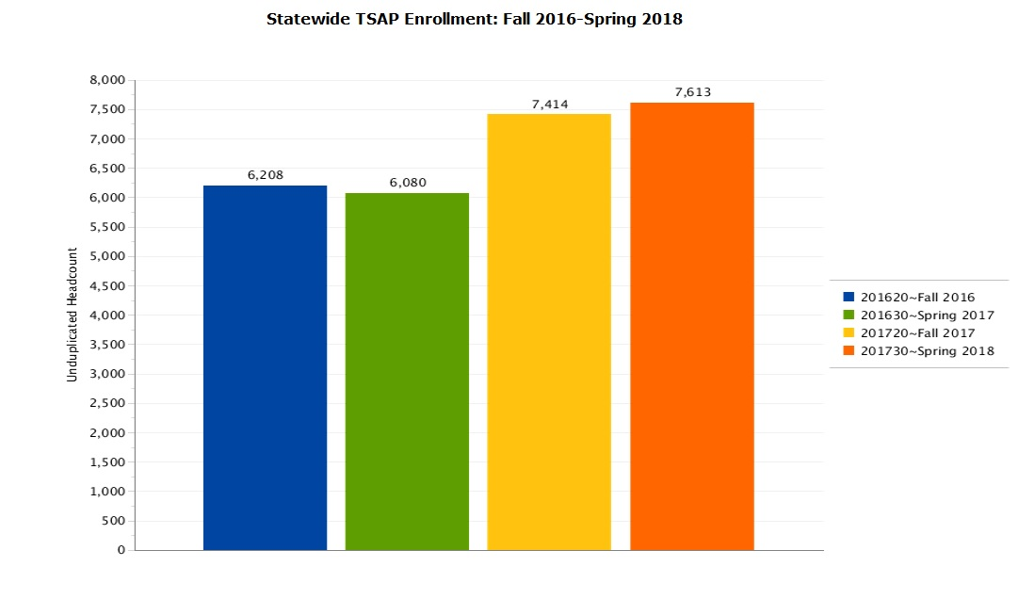

Slide 18
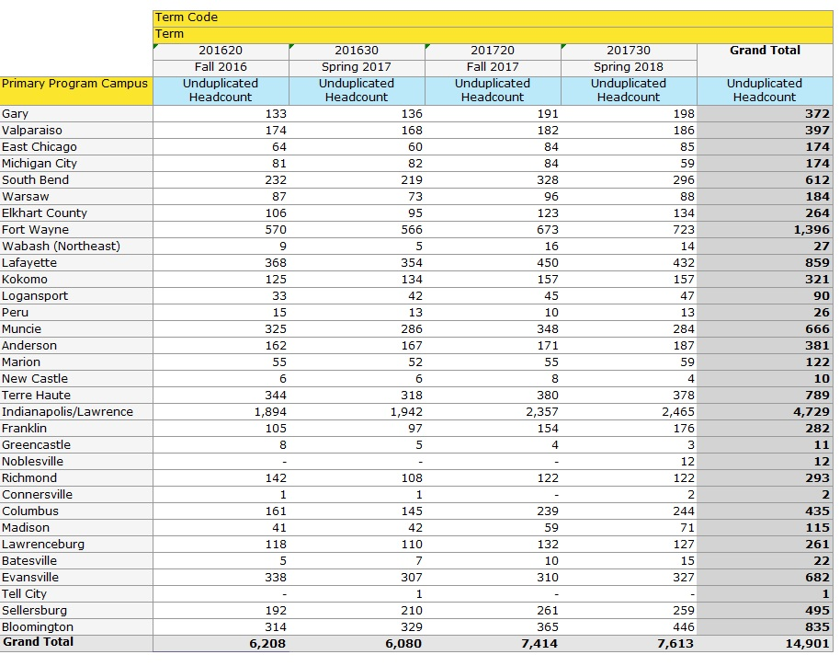
Enrollment by Campus

Slide 19
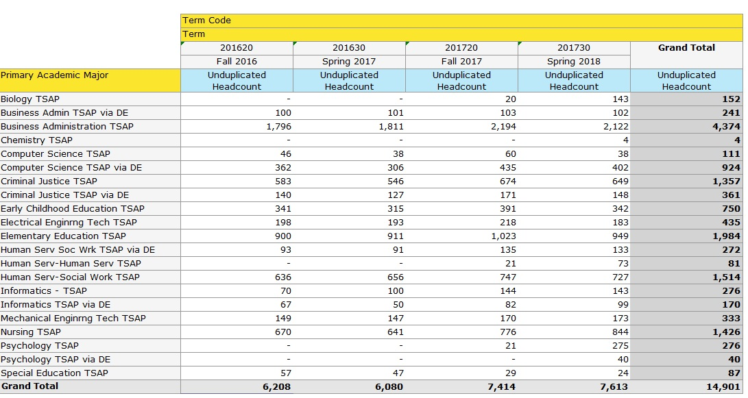
Enrollment by Primary Program

Slide 20
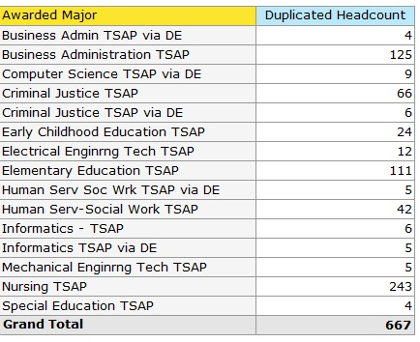
Completions by Program
5

Slide 21


Slide 22
Indiana University.
A Four Year Perspective.

Slide 23

Transfer Single Articulation Pathways
At the 4-Year Campus

Slide 24
Overview
Phases of the TSAP Transfer + Completion Process
  Entry
  Assessment
  Persistence
Notes:
* Entry - credit comes in, flagged thru TSAP, credit as package, admission
* Assessment - completed coursework, admission to program, certification of completed TSAP
* Persistence advised like IU student with tools and completed associates
- Point out the degree is no different
Pathway Vs. Front door,. Same credentials
Competency.

Slide 25
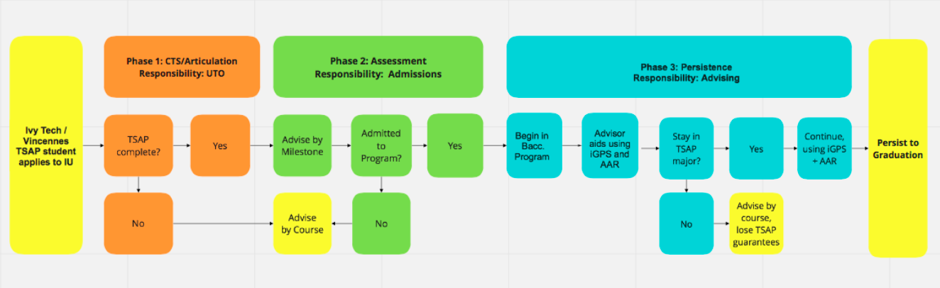
TSAP Flow: The Student Experience
Notes:
Phase 1. Student comes from a 2-year campus, where their advisor has been assisting them. The UTO helps process their credit and channel them to their campus of choice.
Phase 2. Admissions and Advisors assess their milestone completion and admittance to program (if milestone not complete, or if not admitted to program, credit comes in by course).
Phase 3: Department advisors help students plan next two years to graduation, using iGPS and AAR, and to adapt in case students changes major. This goes through graduation.

Slide 26
Degree Components
At Either or Both
Campus Requirements (Gen Ed & Departmental)
At 2-year Campus
At 4-year Campus
Statewide Transfer General Education Core (STGEC)
Major Courses (upper division)
Prerequisites
Major Courses
(lower division)
Electives
Notes:
Associate Degree Components – these happen at 2-year campus
Baccalaureate Degree Components – these happen at IU or 4-year campus

Slide 27
Advising
  Milestones are based on competency, but still articulate as courses
  Student admission status: campus + program
  What if the student leaves the TSAP path?
    Course articulations & new degree fit
    On-time graduation goals remain (without TSAP Guarantee)

Slide 28
The University Transfer Office
System Tools and Implementation
Policies and Guidance Documents
Course Articulation Rules
Credit Transfer Service
Program-Level Articulations
Notes:
This slide focuses specifically on the interfacing of UTO with TSAP. UTO applies course articulation rules, provides CTS, and forwards credit to programs for evaluation and articulation.
Degree planning and the iGPS:
Advising via the AAR (Academic Advising Report)
AAR informs the registration and Degree Map (iGPS)
iGPS reflects the student enrollment needs

Slide 29
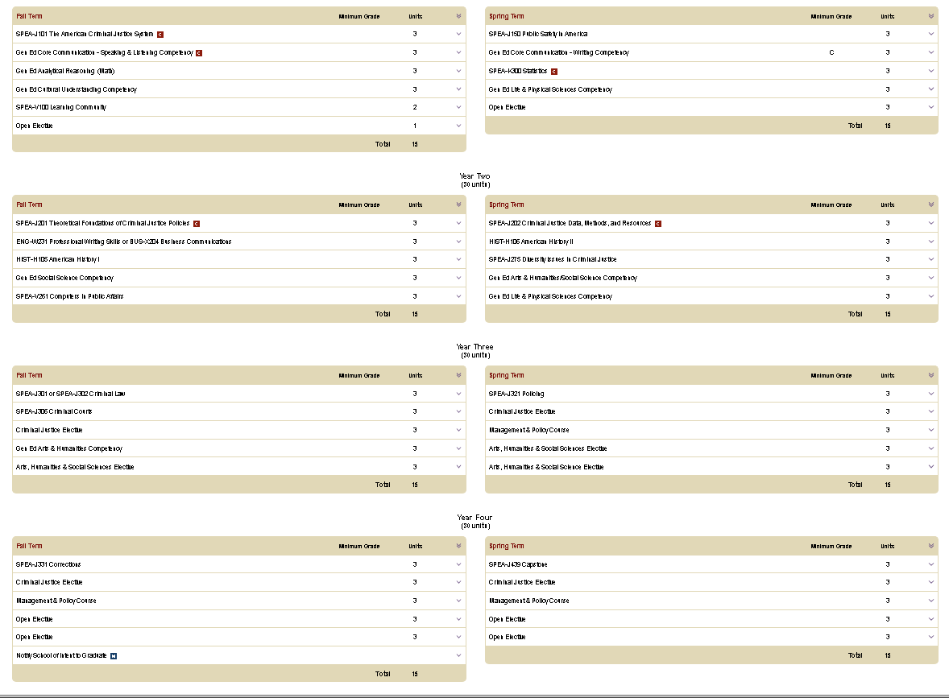
Degree Maps
iGPS
Sample
Degree Map
4-year plan
BS in Criminal Justice (IUPUI)
Notes:
What is the difference between the degree map of a 4-year IU student and a TSAP student? This is the iGPS plan of a Criminal Justice student spending 8 semesters at IU from freshman entry to graduation.

Slide 30


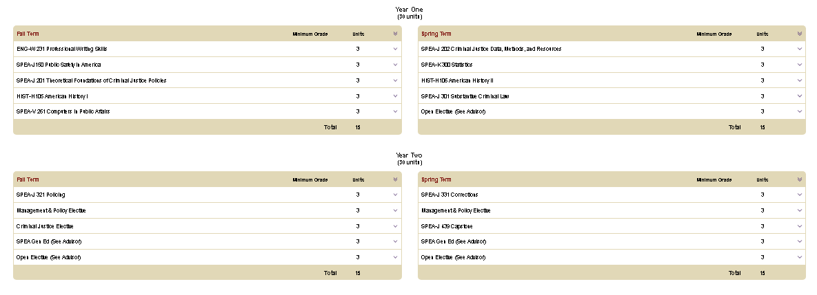
Degree Maps
iGPS
Sample
Degree Map
TSAP plan
BS in Criminal Justice (IUPUI)
TSAP Associate Degree
completed at
Ivy Tech or Vincennes
Notes:
This slide shows the iGPS map for a TSAP Criminal Justice student coming to IU and finishing their degree in 4 semesters. This is where we’re wrapping up, so open for questions. .

Slide 31
System and Process Overview
Key:
Green = System Tool
Blue = Action Descriptions
Yellow = Status Review
Notes:
This chart represents the system/advising view of the students’ process.
Admissions reviews student, assesses completion of TSAP and admission into program.
Advisor helps student build map in iGPS, based on program requirements, past achievement, and remaining needs.
Helps student register for courses.
Repeat every semester assessing achievements and goals until graduation.

Slide 32
Transfer Talk #3
Thursday, May 17, 2018: 1:00 – 2:00 PM (Eastern)
Register now on IndianaTransferCouncil.org
Topic: Great Partnership Programming Efforts for Smooth Transfer Transition
Does your program provide unique opportunities for transfer student support? If so, we would like to learn more.
Please respond to the survey coming to you this afternoon to let us know about your exciting initiatives which may be highlighted during May’s Transfer Talk.

Slide 33
Thank you for joining us!
Please email info@indianatransfercouncil.org with questions and visit indianatransfercouncil.org for the slides.

