Slide 1
Transfer Talk #1
March 15, 2018
1:00 – 2:00 PM
Slides will be available on IndianaTransferCouncil.org after the Transfer Talk.
Please feel free to ask questions throughout the presentation in the Group Chat Box.

Slide 2
Agenda for Transfer Talk #1
1:00 – 1:05 PM – Welcome and Presenter Introductions, Overview of Transfer Talk
1:05 – 1:20 PM – Indiana Transfer Data Report – Gina Deom, Director for Research and Analytics, Indiana Commission for Higher Education
1:20 – 1:30 PM – Discussion of Data Report
1:30 – 1:45 PM – TransferIN.Net Overview – Dawn Clark, Assistant Director of Academic Affairs, Indiana Commission for Higher Education & Tari Lambert, Director TransferIN, Indiana Commission for Higher Education
1:45 – 1:55 PM – Discussion of TransferIN.Net
1:55 – 2:00 PM – Closing and Information about State of Higher Education Address
on April 9

Slide 3
Presenters
Gina Deom
Director for Research and Analytics
Indiana Commission for Higher Education
gdeom@che.in.gov
Dawn Clark
Assistant Director of Academic Affairs
Indiana Commission for Higher Education
dclark@che.in.gov
Tari Lambert
Director, TransferIN
Indiana Commission for Higher Education
tglambert@bsu.edu

Slide 4
Indiana Commission for Higher Education Overview
Created in 1971 by an act of the General Assembly and signed into law by then Governor Edgar Whitcomb, the Indiana Commission for Higher Education is now in its fourth decade of service to the State of Indiana. The Commission is a fourteen-member public body created to:
Define the educational missions of public colleges and universities;
Plan and to coordinate Indiana’s state-supported system of post-high school education, taking into account the plans and interests of independent colleges and universities;
Review both operating budget and capital budget appropriation requests from public institutions;
Approve or disapprove for public institutions the establishment of any new branches, campuses, extension centers, colleges or schools;
Approve or disapprove for public institutions the offering of any additional associate, baccalaureate or graduate degree or certificate program of two semesters or more in duration;
Review all programs of public institutions and make recommendations to the governing board of the institution, the Governor, and the General Assembly concerning the funding and the disposition of these programs; and,
Distribute student financial aid from state aid programs.

Slide 5
Commission Initiatives/Responsibilities
Core Transfer Library (CTL)
Statewide Transfer General Education Core (STGEC)
Transfer Single Articulation Pathways (TSAP)
Advanced Placement (AP)
College-Level Examination Program (CLEP)
Dual Credit
Military Credit
E-Transcript
Credential Engine
You Can. Go Back.
Midwest Student Exchange Program (MSEP)
Reciprocity
Distributing State Financial Aid
Adult Student Grant
Next Generation Hoosier Educator Scholarship
Financial Aid Appeals
Complaints
Proprietary Education
Academic Program Inventory
Learn More Indiana
21st Century Scholars

Slide 6
College Transfer and Student Success Report
Indiana Transfer Council: Transfer Talk #1
March 15, 2018
Gina Deom, Director for Research and Analytics

Slide 7
ICHE DATA COLLECTION/REPORTS
CHEDSS (longitudinal enrollment/degree database)
Annual reports
College Readiness
Completion
Return on Investment (ROI)
Other supplement analyses, including:
Dual Credit
Certificates
Transfer
www.in.gov/che

Slide 8
THE BIG PICTURE OF TRANSFER
Student mobility is increasing
+15% increase in student transfers since 2007
40% of transfers do so more than once
Transfer credit is becoming more important for students
+25% increase in transfer credit accepted since 2007
Transfer pathways offer important alternative routes to a degree, boosting overall completion rates.

Slide 9
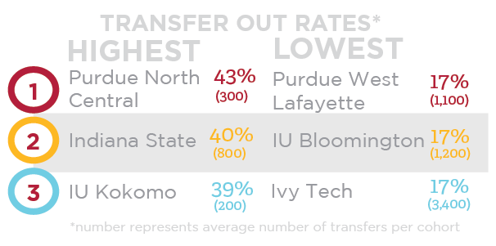
HOW MANY TRANSFER?
In Indiana, about 1 in 4 students (25%) who enter college for the first time at an Indiana public institution transfers to a different campus or institution at least once within six years.

Slide 10
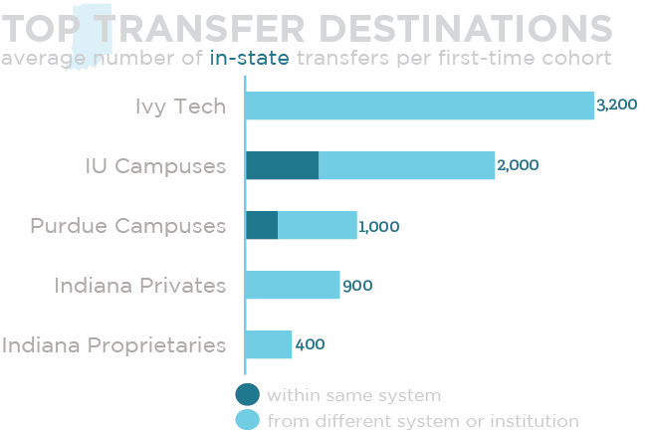
WHERE DO THEY GO?
About 7 in 10 stay in Indiana, of those:
Notes:
Many out of state students choose institutions near the border or online schools

Slide 11
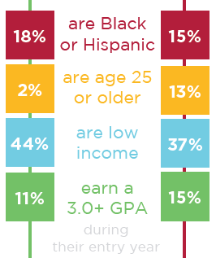
WHO ARE THEY?
On average, transfers tend to be younger, have lower first year GPAs, and are less likely to be white.
About 6% of 2 to 4 year transfers earn an associate prior to transferring
^{4 to 2 Year}
^{2 to 4 Year}

Slide 12
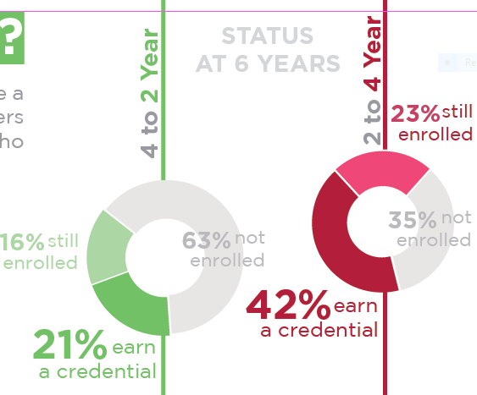
HOW MANY SUCCEED?
About 40% of all transfer students complete a credential within six years, but 2 to 4 Year transfers are about 2x as likely to succeed as those who transfer to a two-year public institution.
Notes:
--slight increases in success rates (1.5%) over past few years, more difficult to move as number of transfers increases

Slide 13
COMPLETION BIG PICTURE
Transfer pathways offer important alternative routes to credentials, boosting overall completion rates.
12% transferred & completed
Total completion rate
completed
at
same campus
6% transferred & completed
completed
at
same campus
Entry Campus
*Six year completion rates

Slide 14
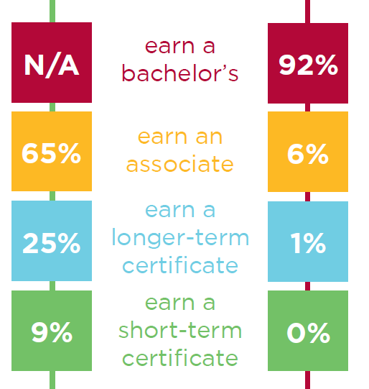
WHAT DO THEY EARN?
^{4 to 2 Year}
^{2 to 4 Year}
The majority of students earn associate or bachelor’s degrees for 4 to 2 Year and 2 to 4 Year transfers, respectively.
Over 25% of 4 to 2 Year transfers earn a certificate.

Slide 15
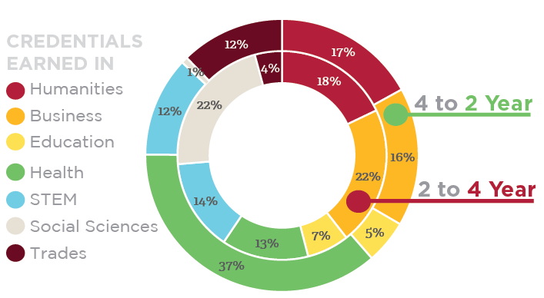
WHAT DO THEY EARN? (Cont.)
4 to 2 Year transfers are about 3x as likely to earn a credential in health-related fields.

Slide 16
KEY TAKEAWAYS
Students are more mobile than ever before, and more credits are being transferred than ever before
The majority of transfers remain in state, with most enrolling at Ivy Tech or IU Campuses
Health and Business are the most common areas of study

Slide 17
QUESTIONS?
Full report posted on ICHE’s website:
http://in.gov/che/3155.htm
Data Requests:
Email: Data@che.in.gov
Other Contact Info:
Email: GDeom@che.in.gov

Slide 18
College Transfer and Student Success Report Discussion

Slide 19
TransferIN.net Overview
Redesign Soft Rollout in December, 2017
Database functionality still being revised – should be complete by May, 2018
What’s the same?
AP, CTL Databases
What is different?
CLEP, TSAP, Dual Credit, Military Bridge Programs Databases
STGEC page with links to institutional STGEC pages
Dual Credit Crosswalks - Downloadable
Expanded Military Section
Guidance Counselor and College Advisor Section

Slide 20
TransferIN.net Navigation

Slide 21
TransferIN.net Discussion

Slide 22
Indiana’s 6th Annual State of Higher Education Address The State of Higher Education Address is part of an ongoing public engagement effort designed to promote college completion and increase the education level of all Hoosiers.
Monday, April 9, 2018 Address: 4:00 pm Reception to follow
State House, South Atrium 200 West Washington Street Indianapolis, Indiana
Registration: https://www.eventbrite.com/e/2018-state-of-higher-education-address-tickets-42277229331
Streaming: http://www.in.gov/che/3024.htm

Slide 23
Sign up on IndianaTransferCouncil.org to be on mailing list, Executive Board, or a Sub-Committee

Slide 24
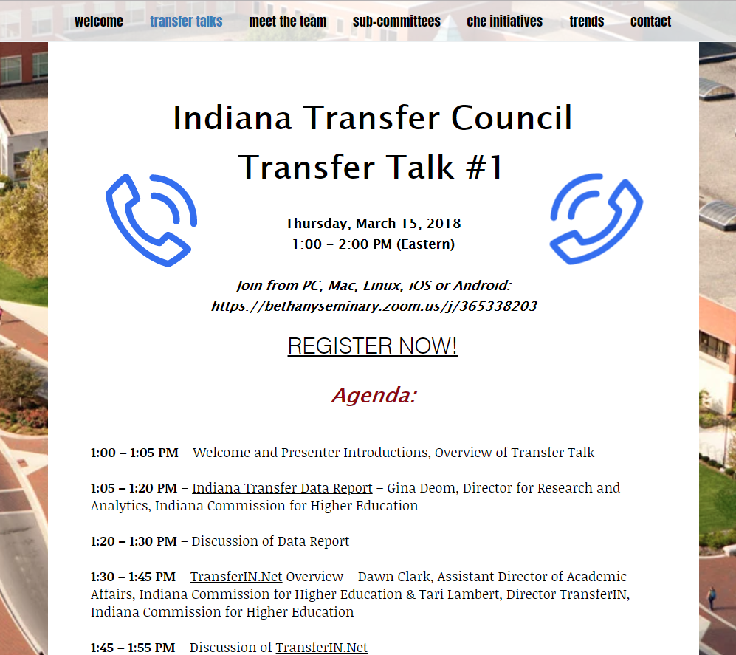
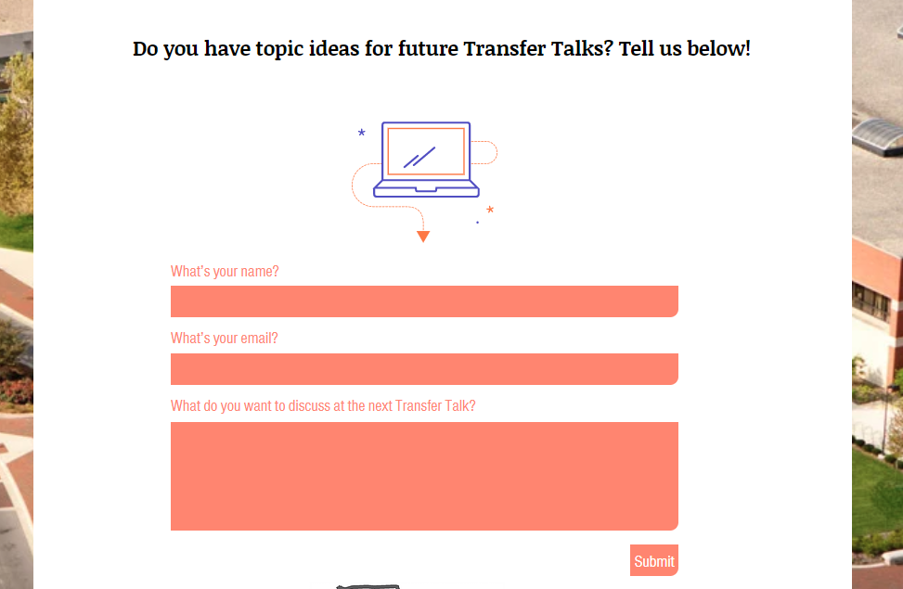
IndianaTransferCouncil.org/transfertalks

Slide 25
Transfer Talk #2
Thursday, April 19, 2018
1:00 – 2:00 PM (Eastern)
Topics: Transfer Single Articulation Pathways (TSAP)
What are they?
How do they work?
What are some best practices?

Slide 26
Thank you for joining us! Please email info@indianatransfercouncil.org with questions and visit indianatransfercouncil.org for the slides.

